Slide 1
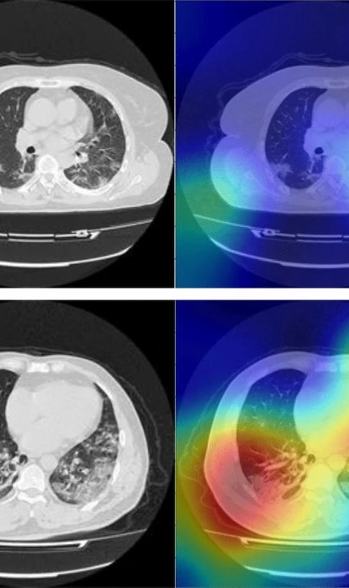
Image processing Of clean and covid lung scans using simpleitk and matlab
CSC821, Prof. Kazunori Okada
Team Forest
Spring 2022

Slide 2
What are the elements of medical image processing?
Registration
Taking two images that are offset, distorted, or otherwise misaligned and mapping them to each other using various methods and algorithms
Segmentation
Using filters to accentuate or suppress features of images in order to accent the ROI (region of interest) for a scan
Quantization
Using mathematical metrics to draw conclusions about the content of images

Slide 3
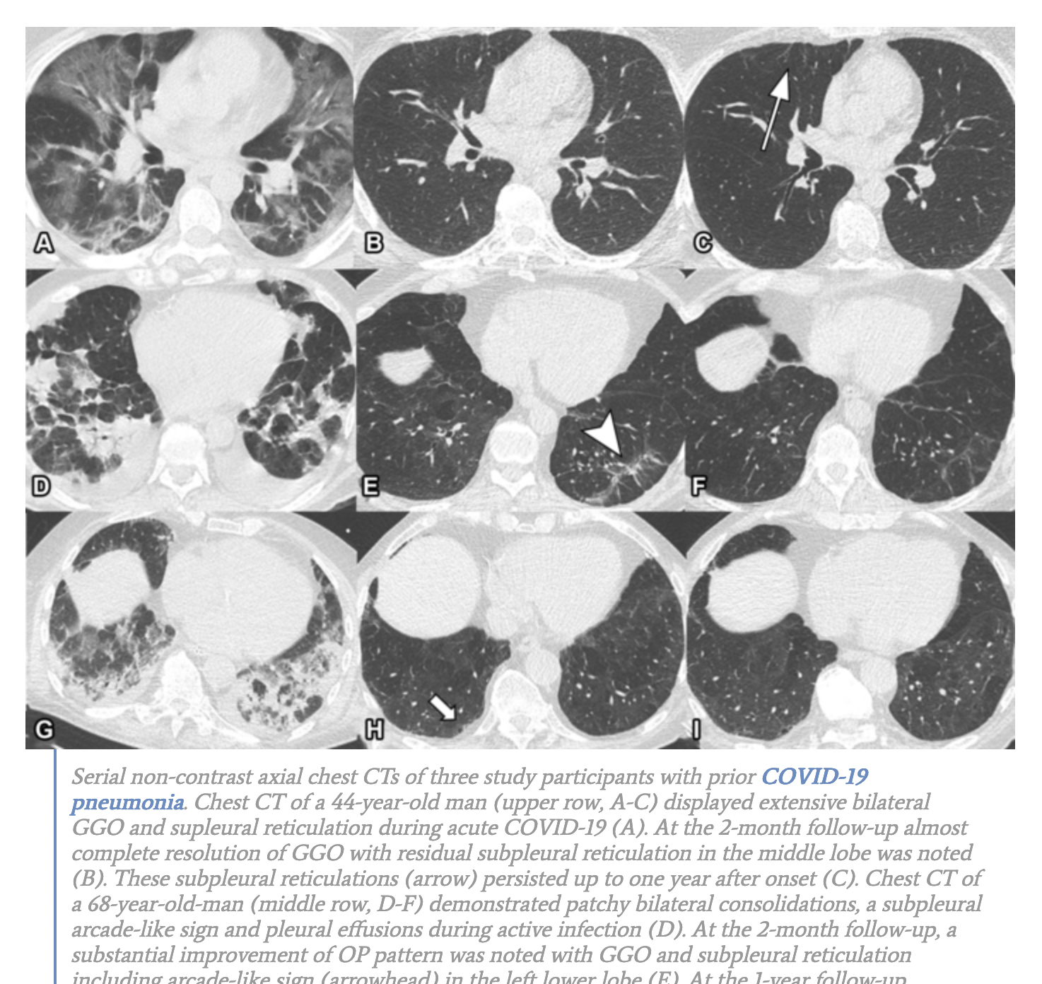
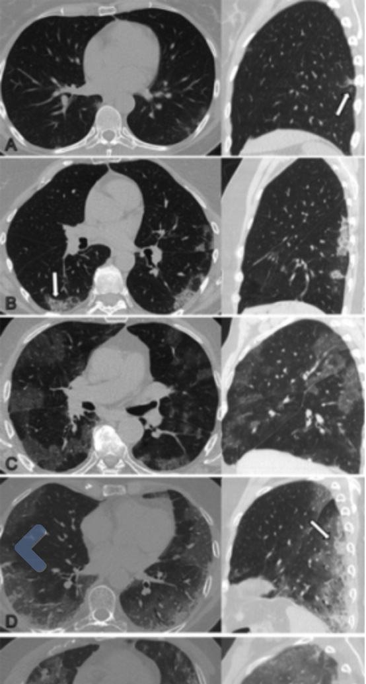
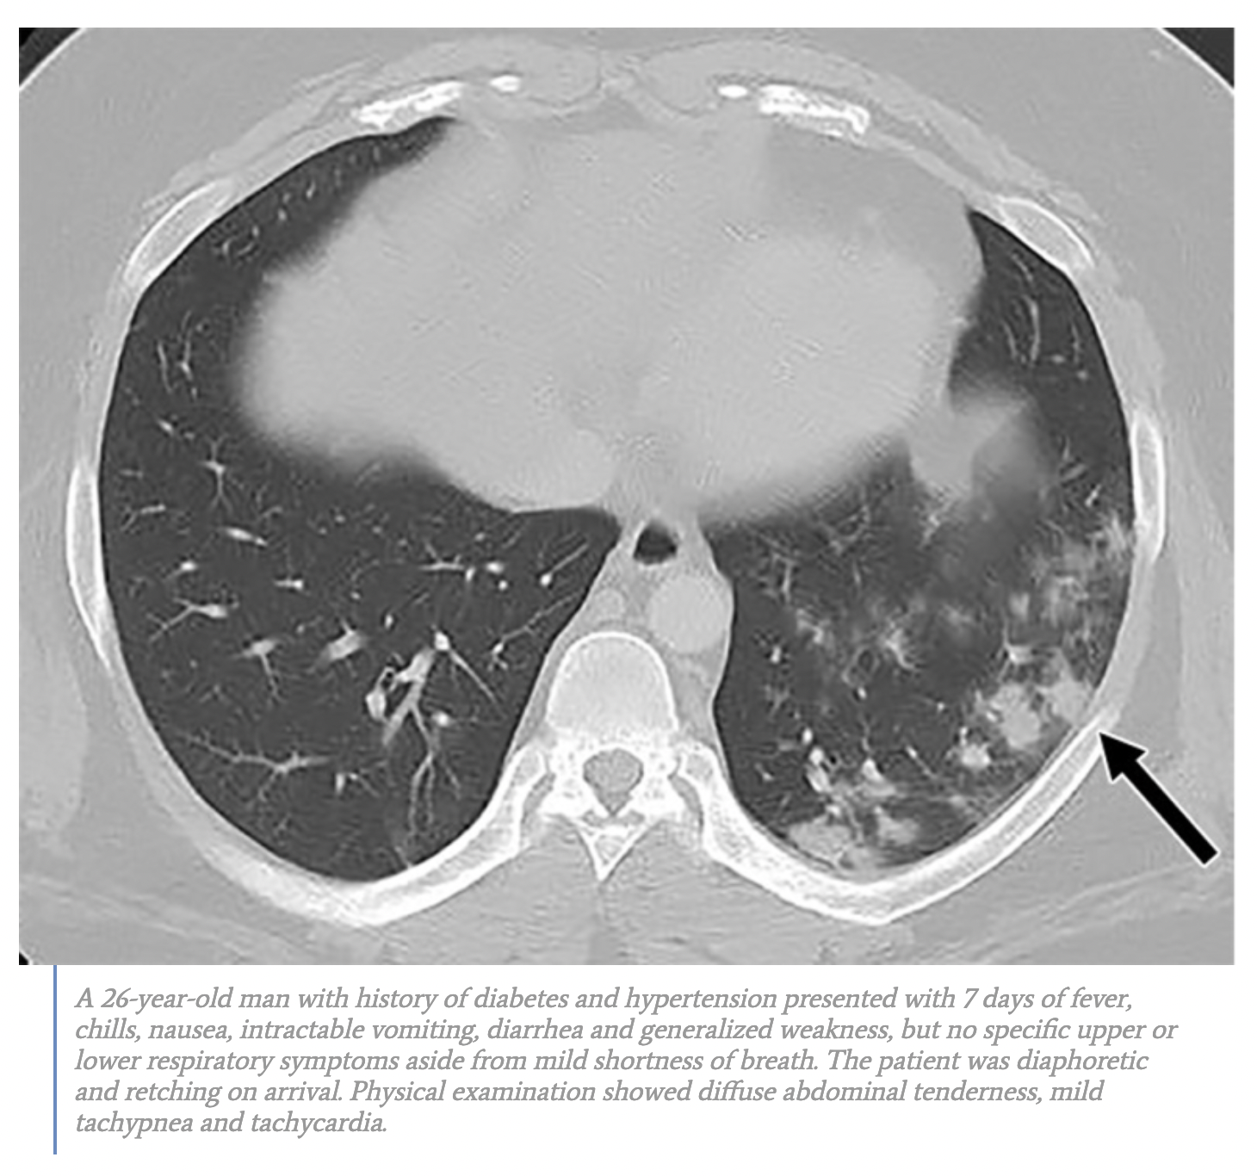
What does covid look like?

Slide 4

Image Registration
Using SimpleITK and Matlab

Slide 5
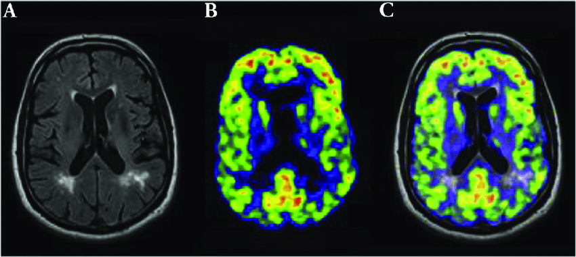
What is image registration?
The process of transforming different images onto the same coordinate set
Allows comparison and integration of images from different sources or methods
Intensity-based or feature-based
Intensity-based methods compare intensity values of images
Feature-based methods find matching image features such as points, lines, and contours
Transformations are rigid or elastic
Rigid methods are linear in nature and use affine methods (rotation, scaling, etc.)
Non-rigid can warp an image to cause it to align with another one

Slide 6
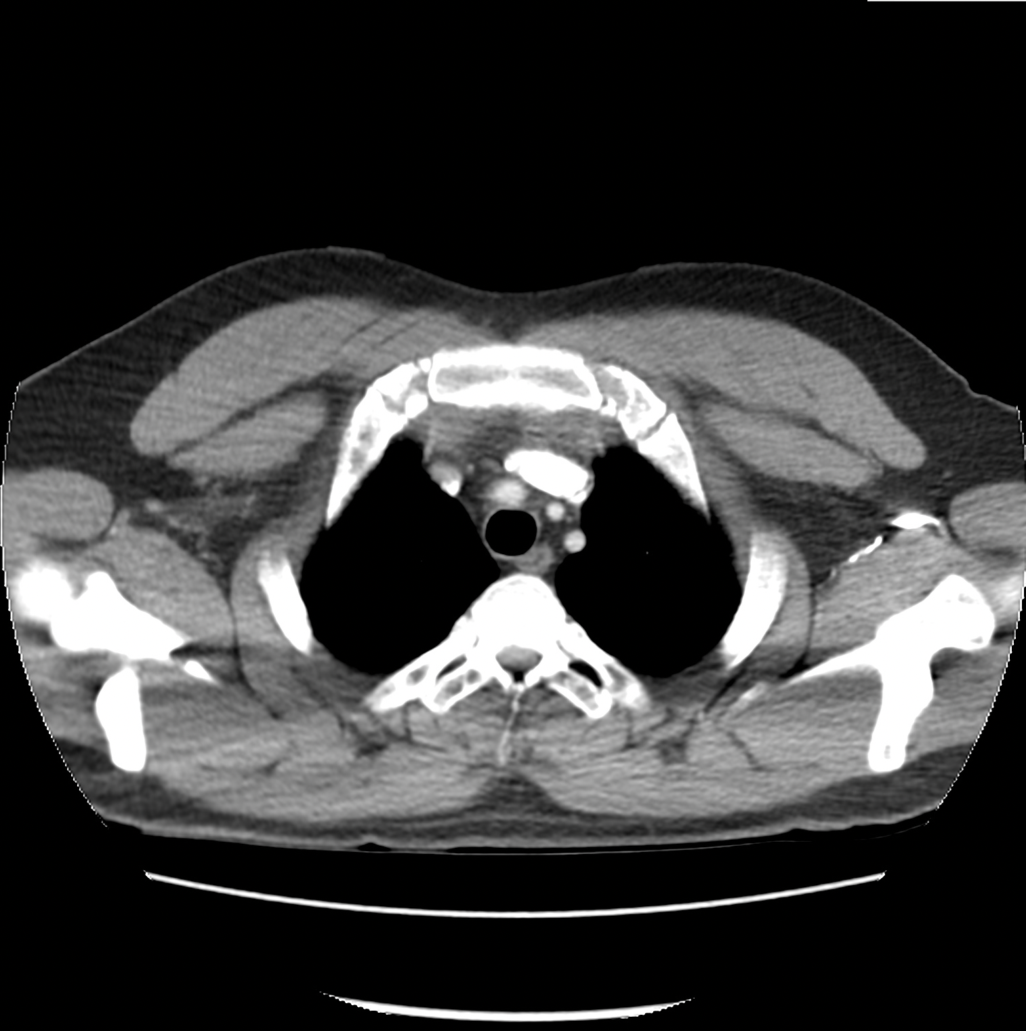
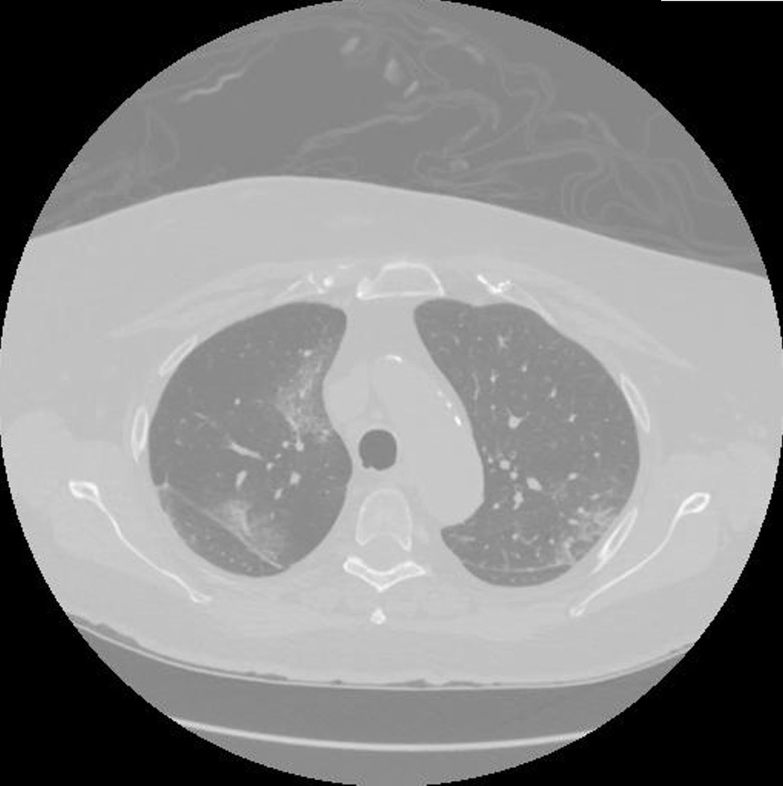
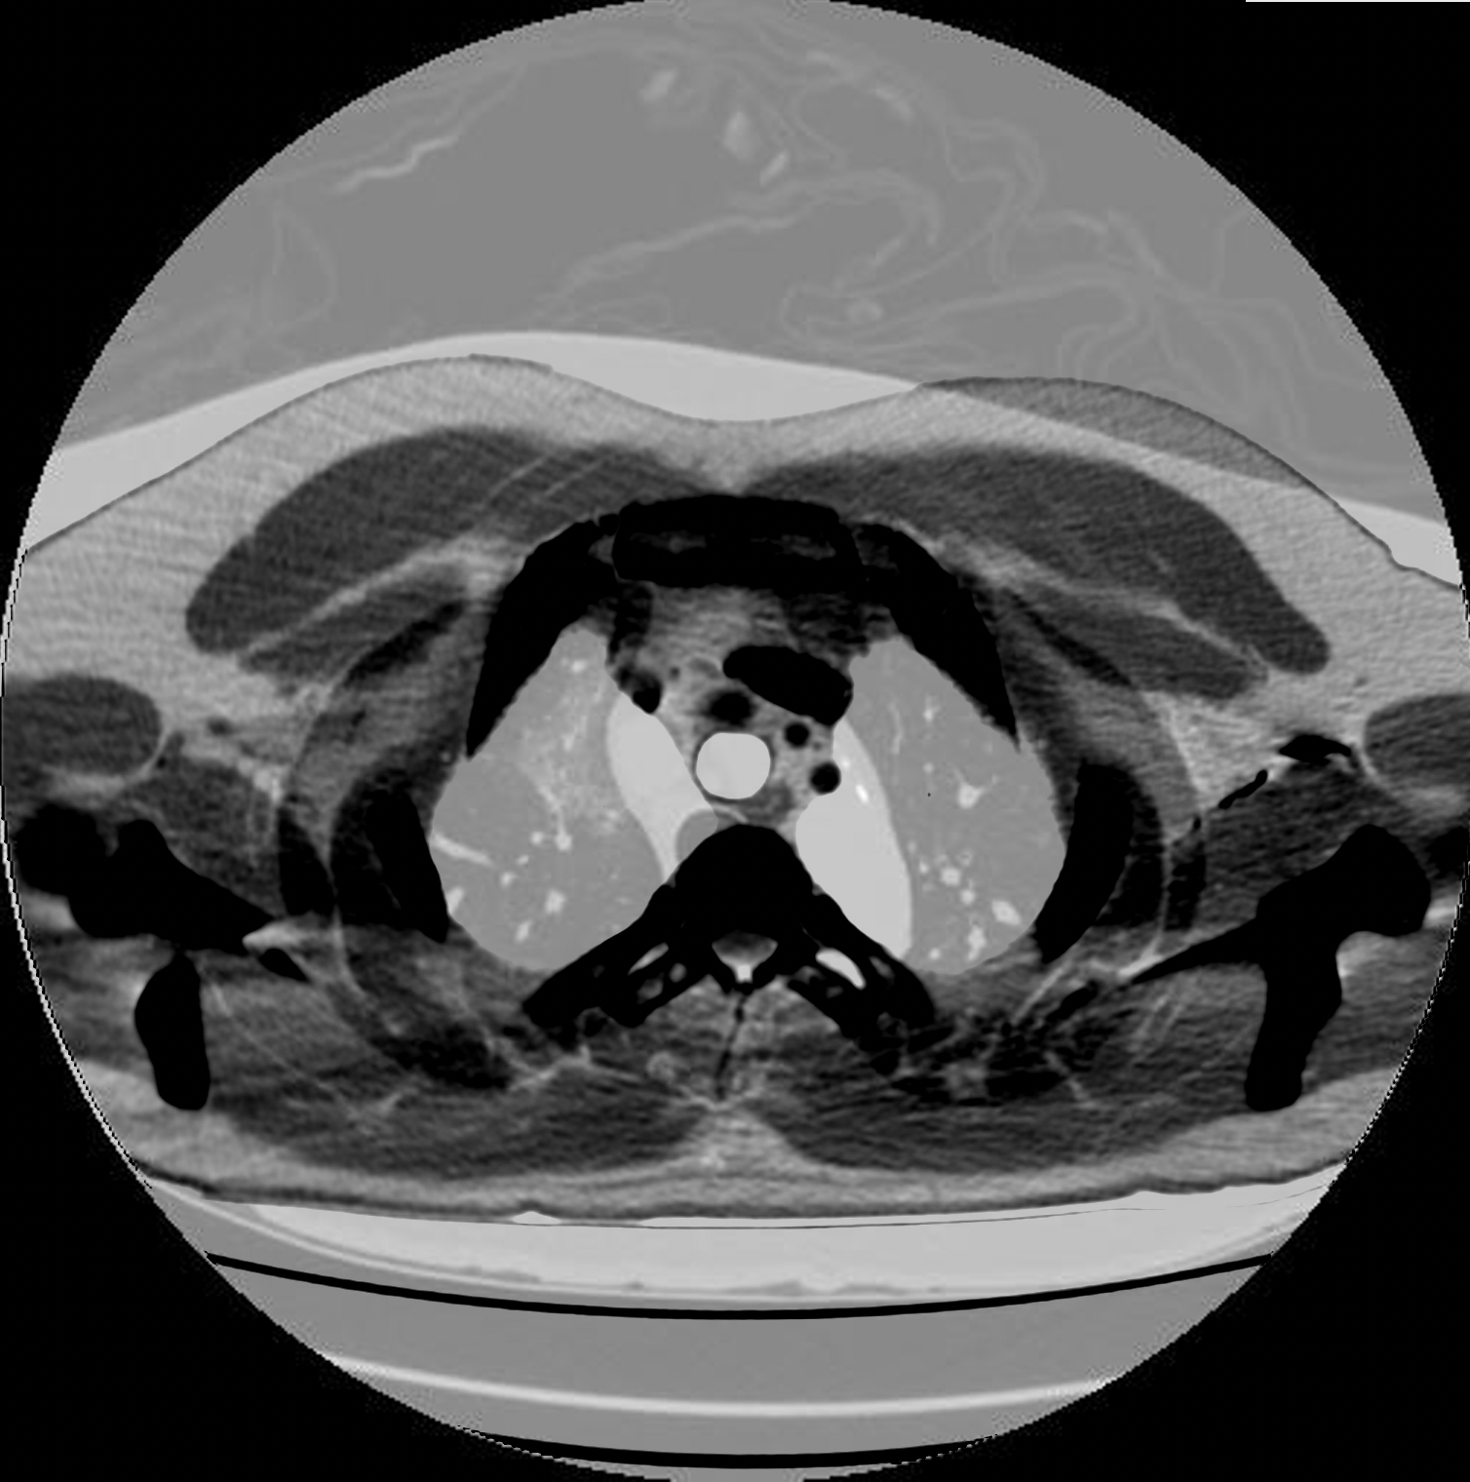
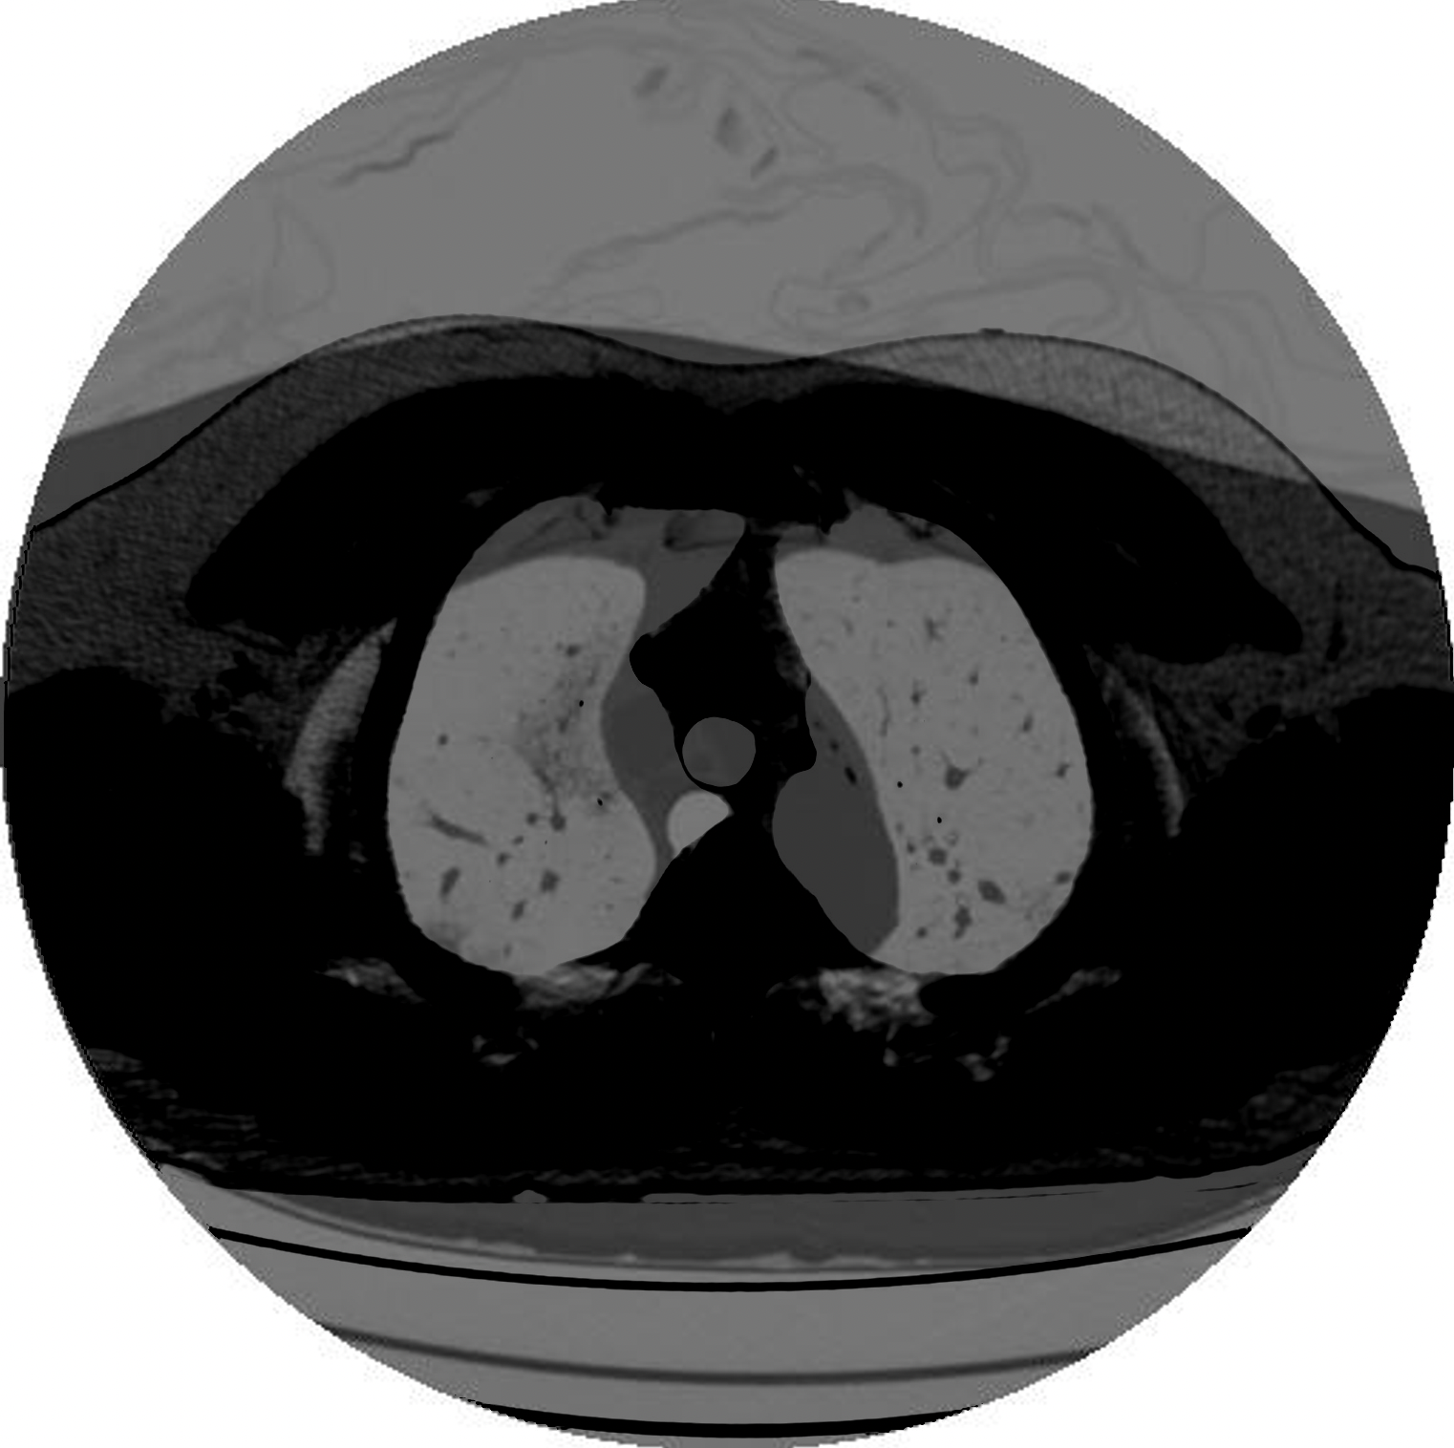
Intial Attempts
Clean Lung
COVID Lung
Image addition/subtraction using Matlab
Using 2D to begin
Subtracting the images resulted in a confusing result
Inverting the moving image and adding them resulted in a clearer picture of spots in the COVID lung
Subtracted Images
Inverse Added

Slide 7
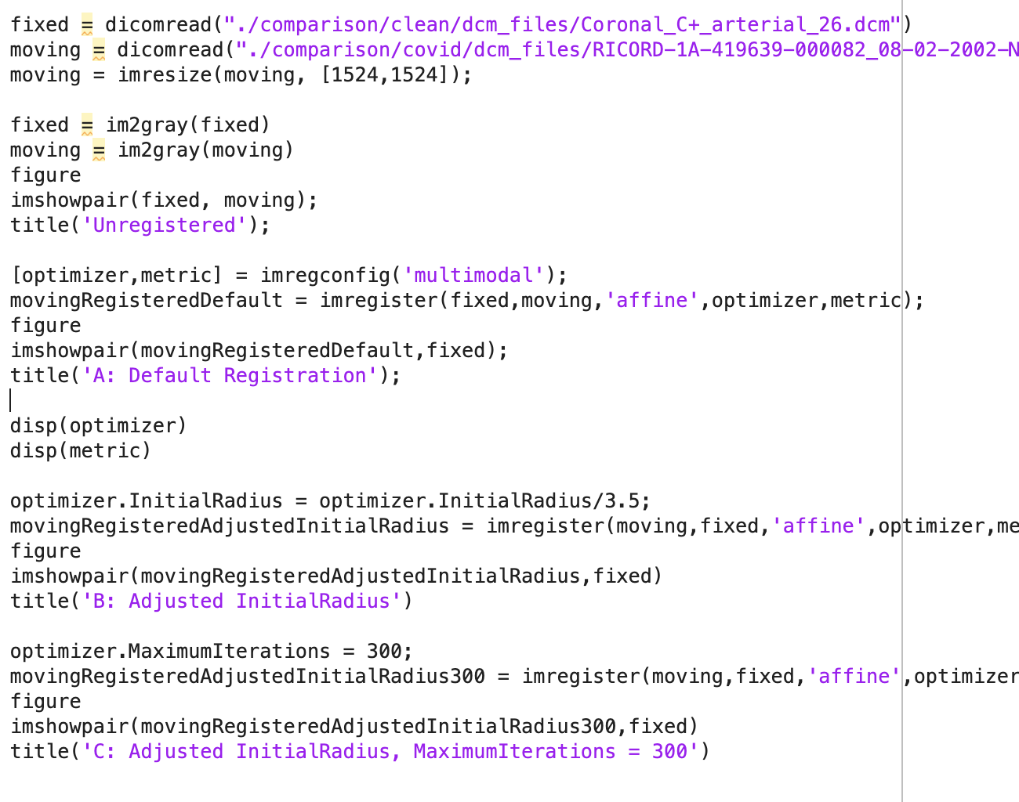
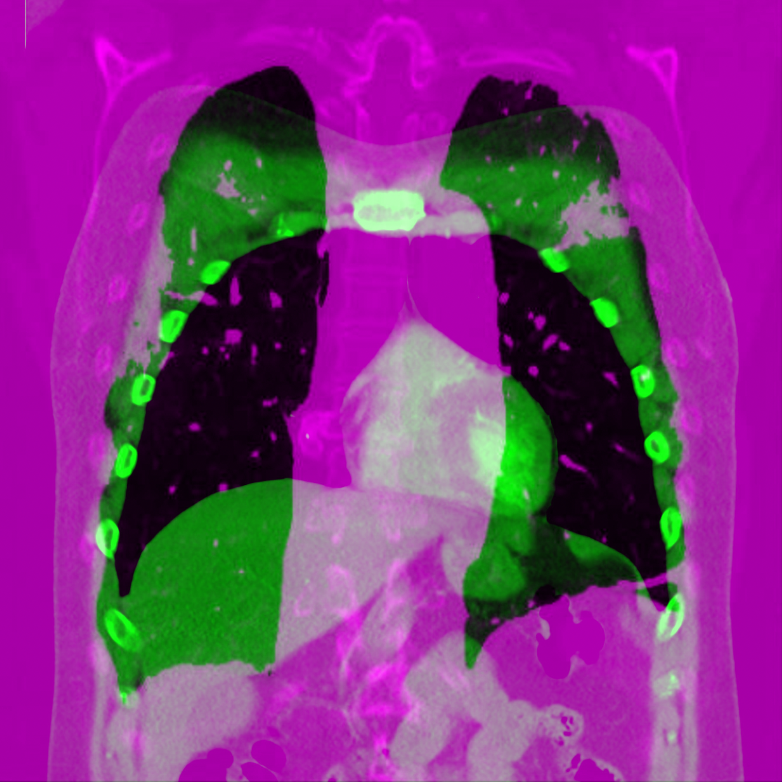
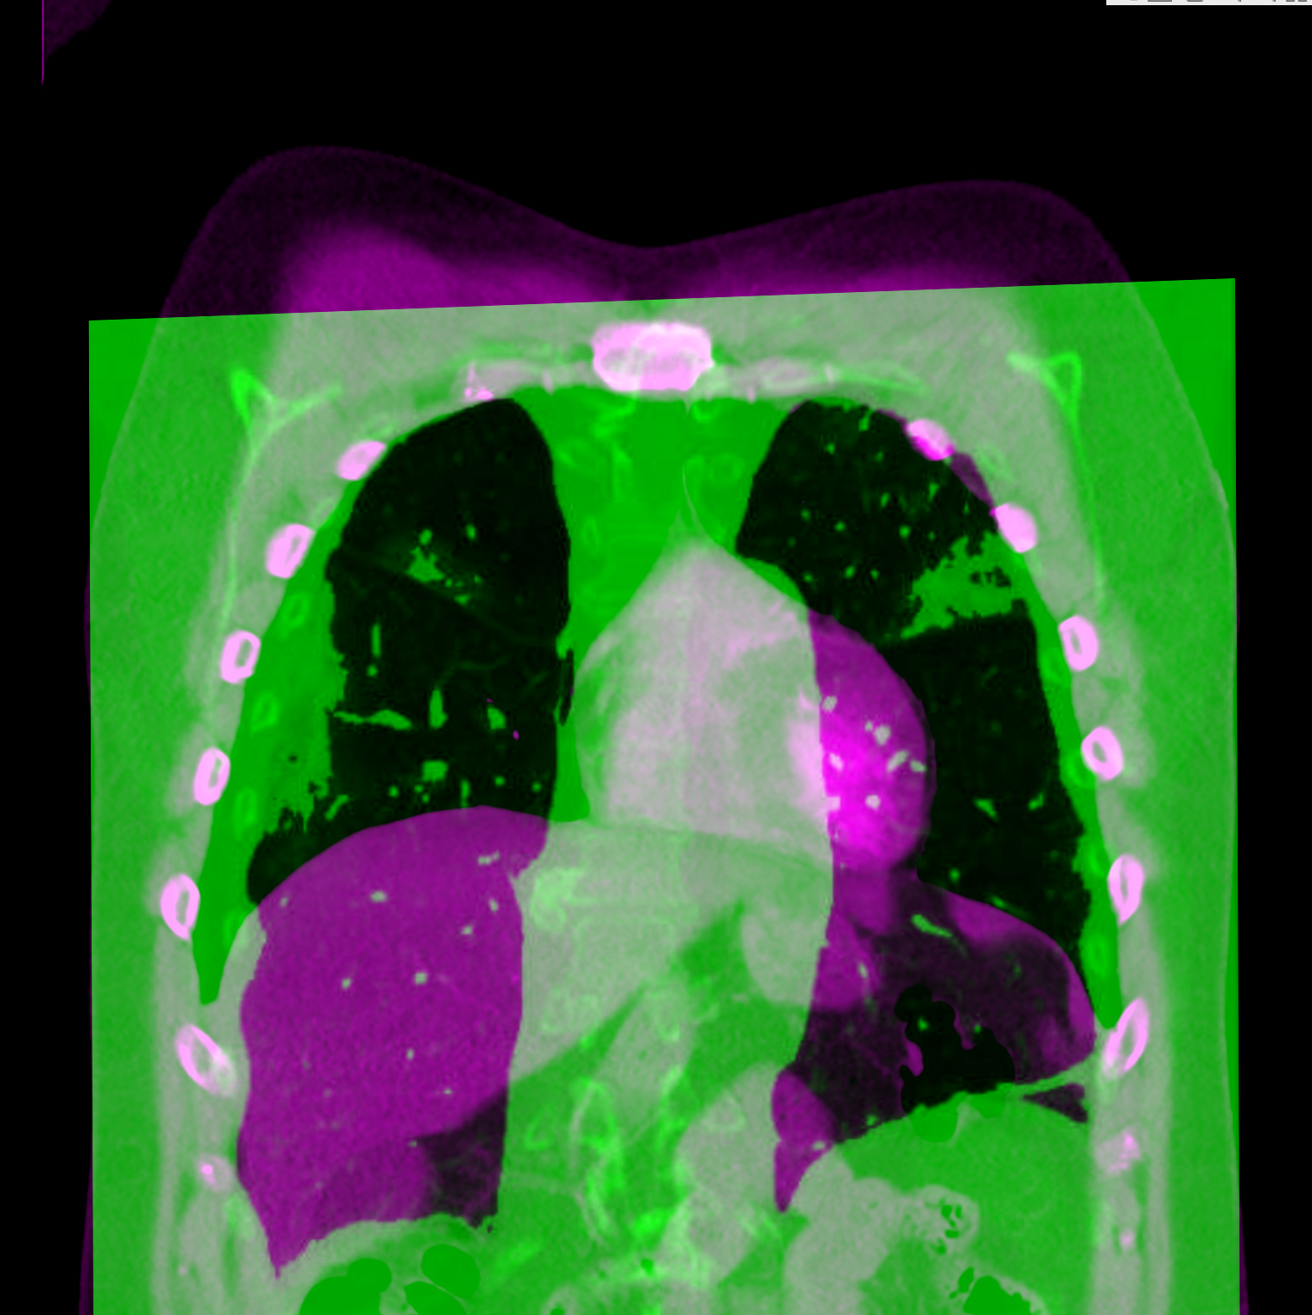
Coronal 2D registration using Matlab
Before
After

Slide 8
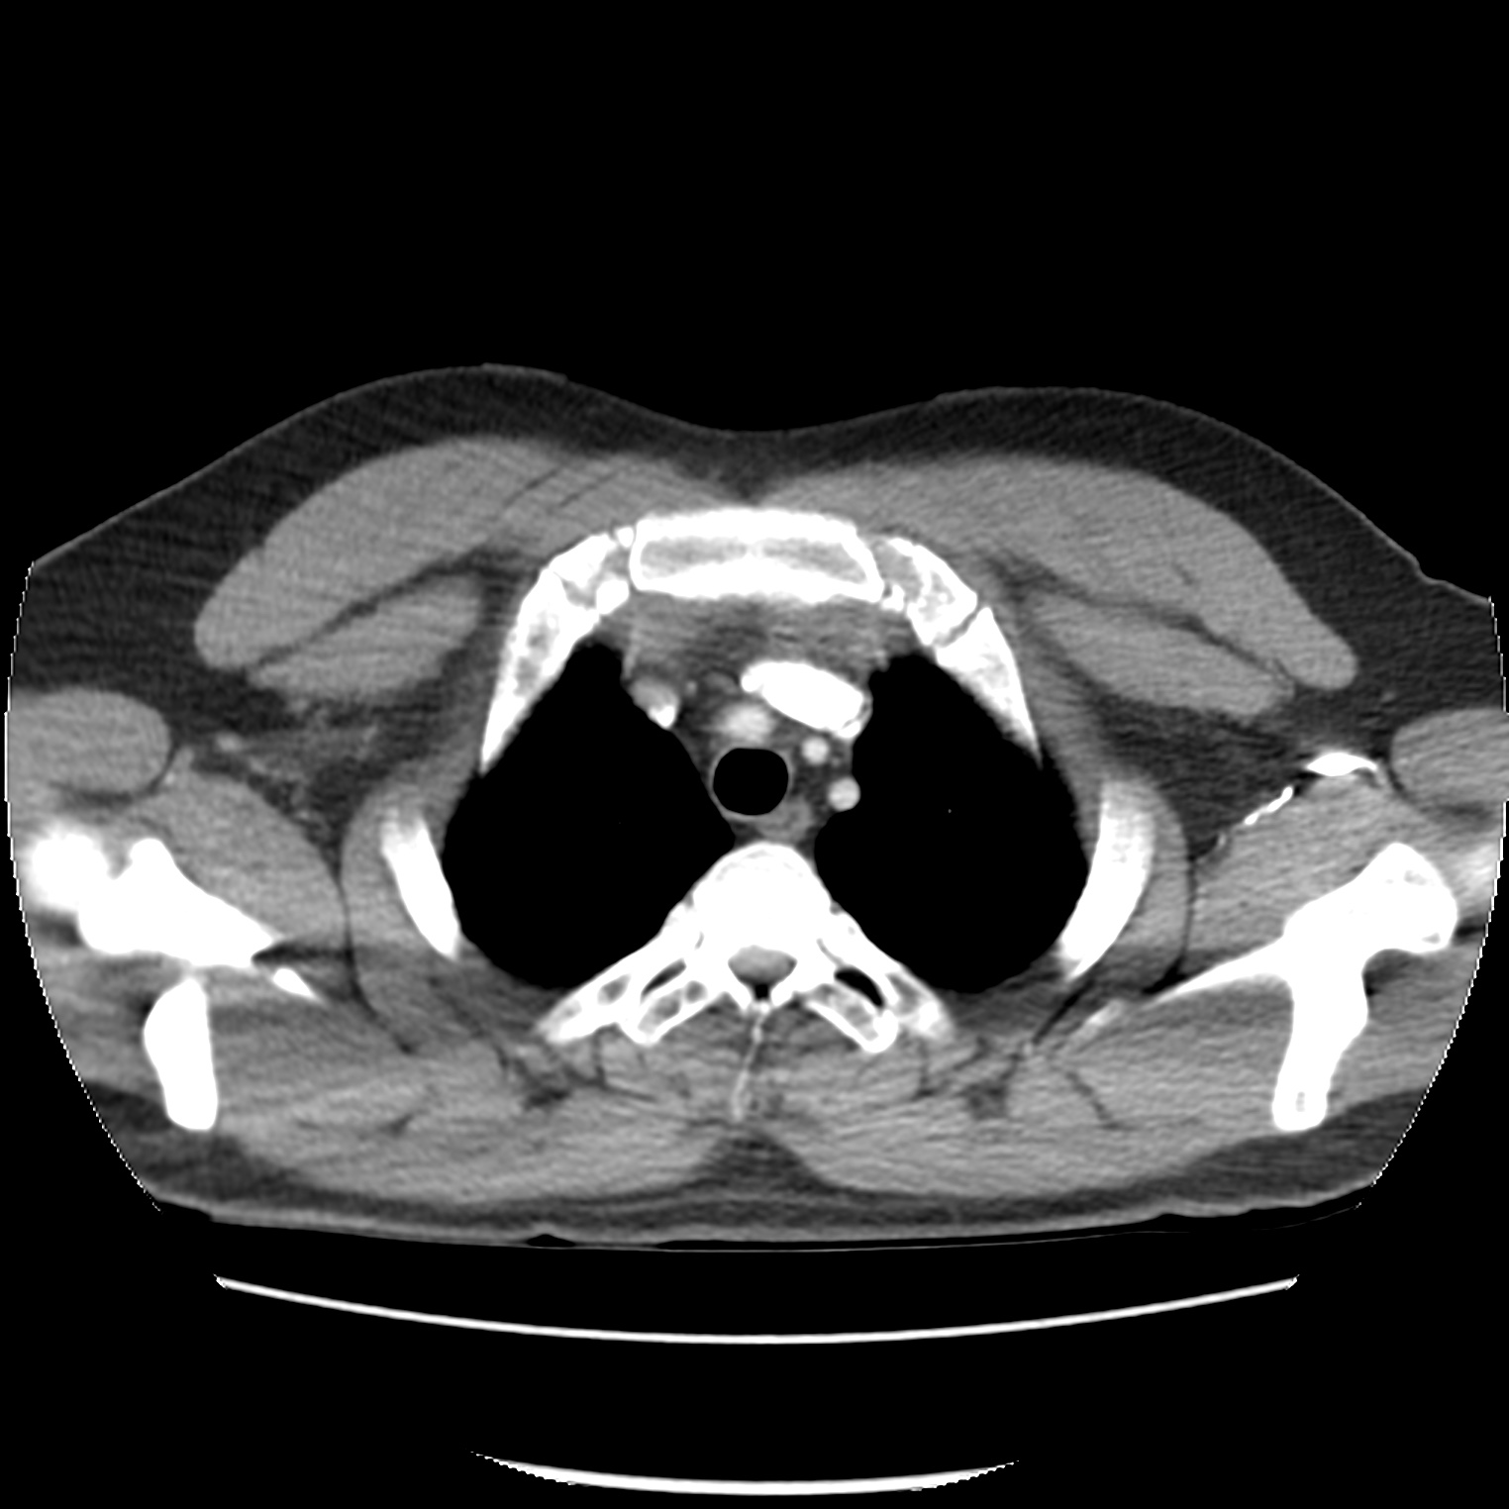
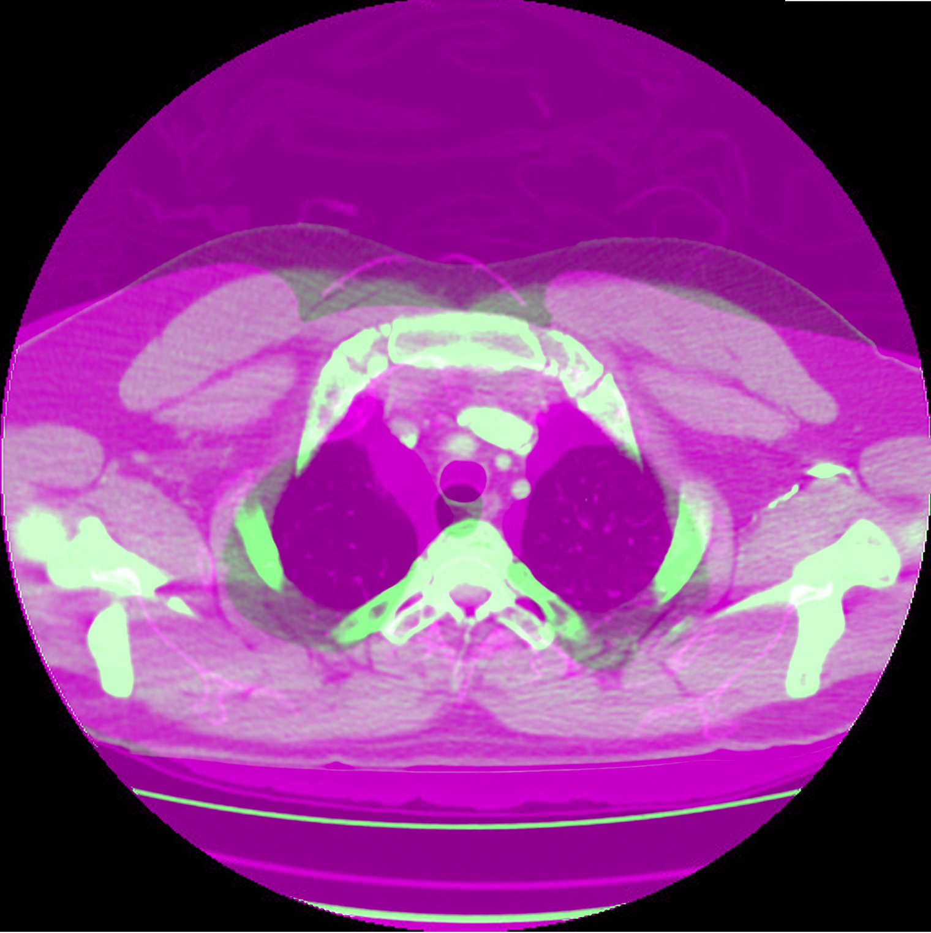
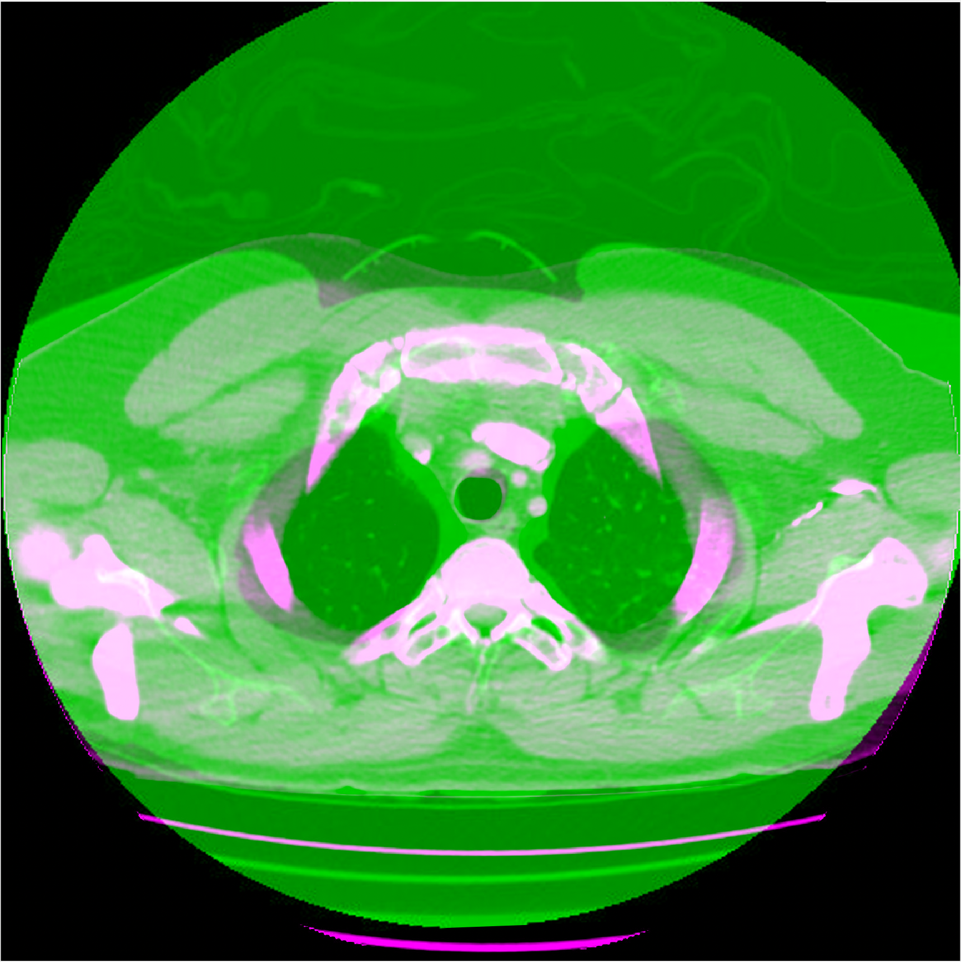
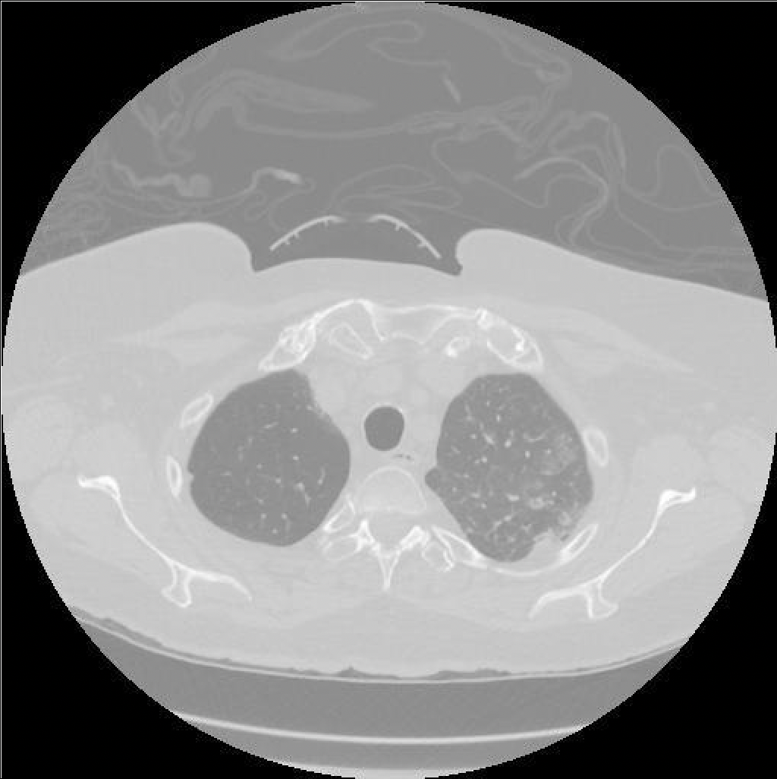
AXIAL 2D registration using Matlab
Before
After

Slide 9
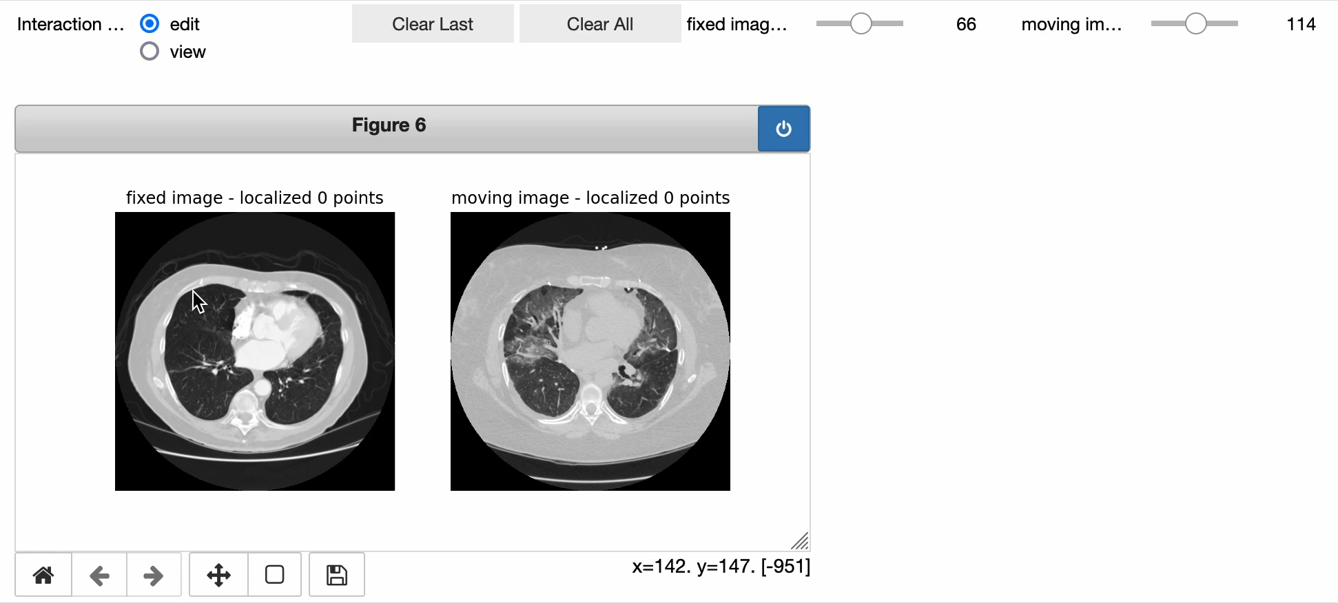
LANDMARKING REGISTRATION USING GUI IN ITK

Slide 10
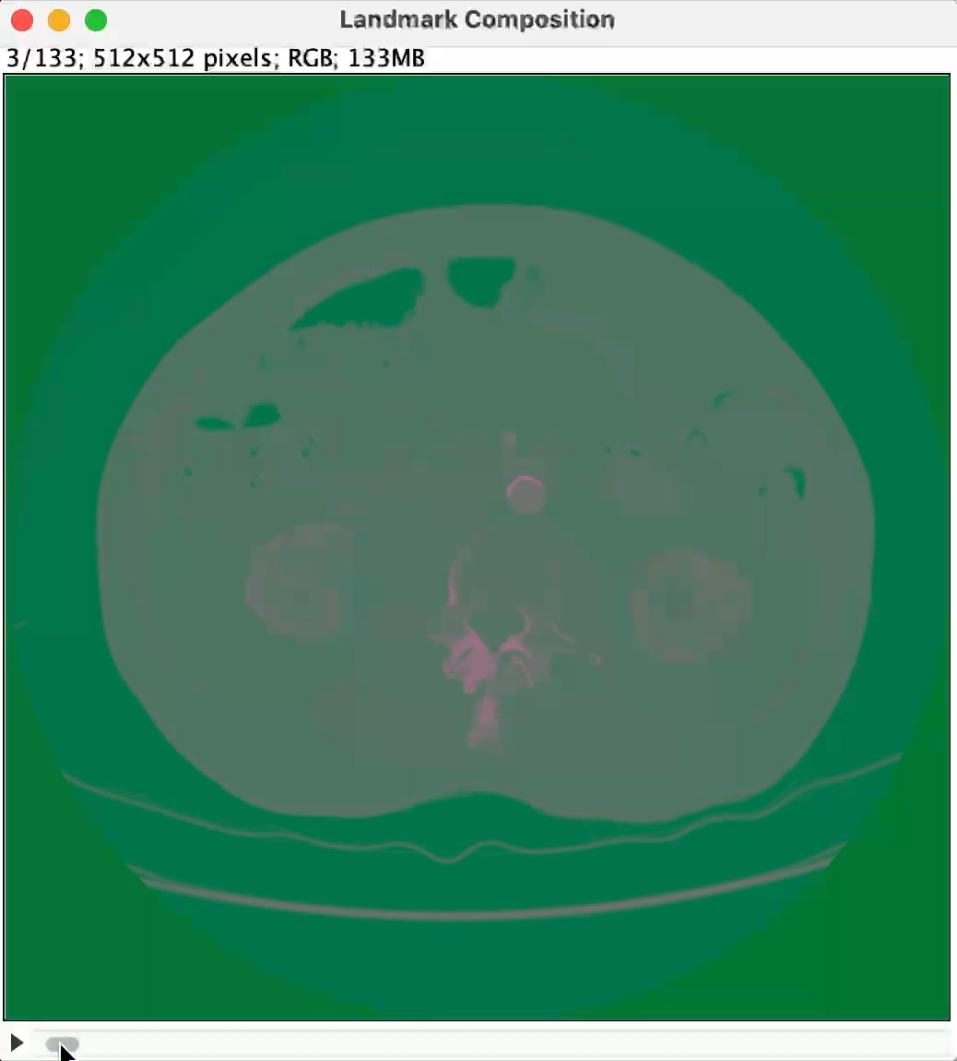
LANDMARKING REGISTRATION OUTPUT

Slide 11
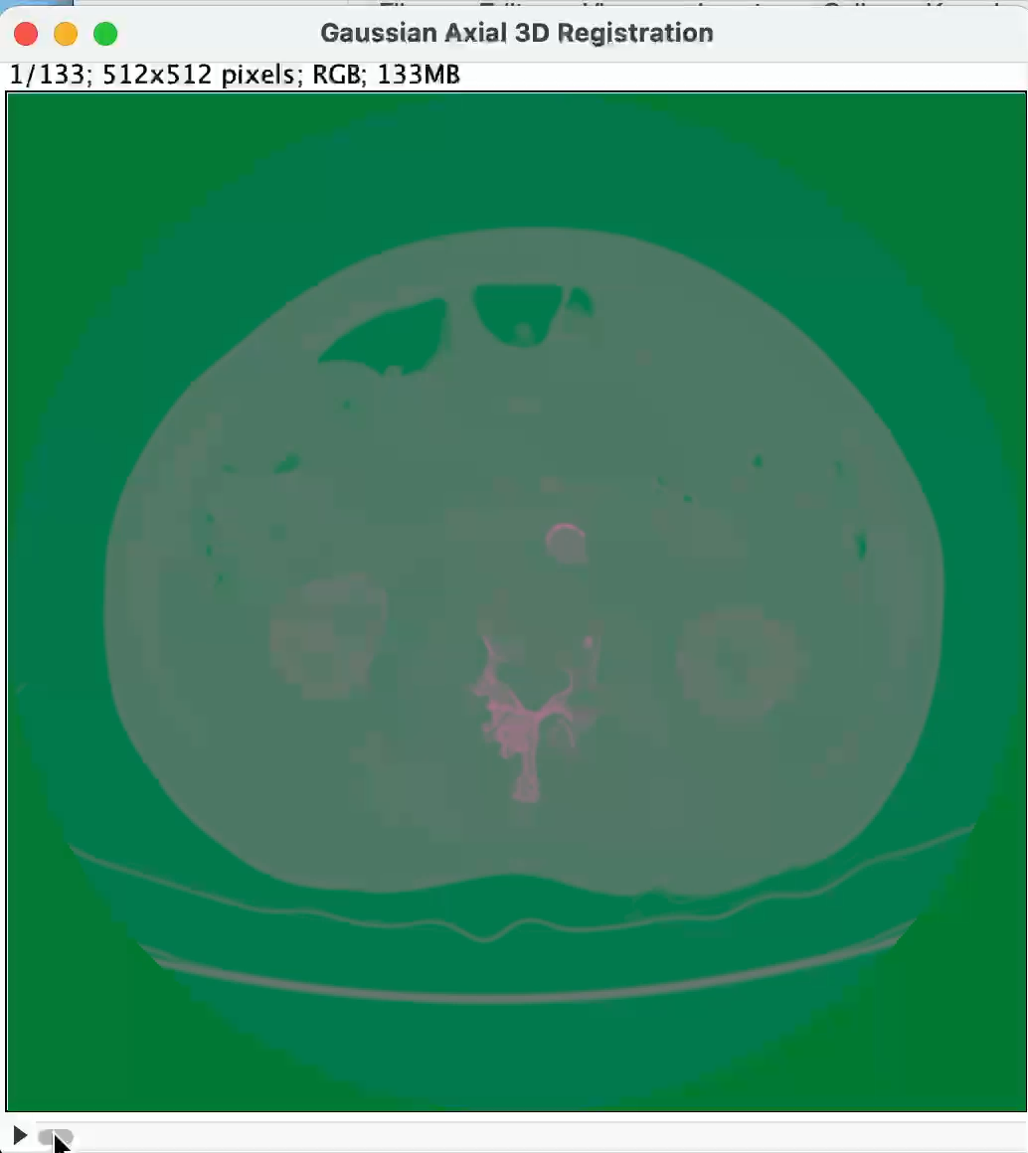
3D SIMILARITY Registration Using SimpleITK
Using similarity based registration, we were able to register images with differing numbers of slices and of different sizes, trying a linear transform and a Gaussian transform

Slide 12
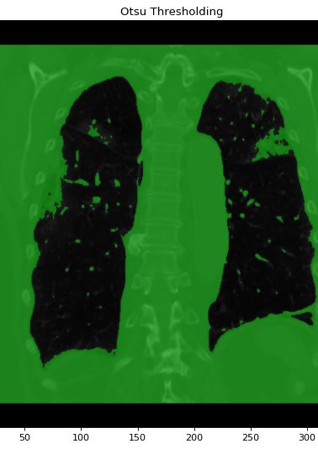
Image segmentation
Image segmentation is considered the most essential medical imaging process as it extracts the region of interest (ROI) through a semi automatic or automatic process. It divides an image into areas based on a specified description, such as segmenting body organs/tissues in the medical applications for border detection, tumor detection/segmentation, and mass detection.

Slide 13
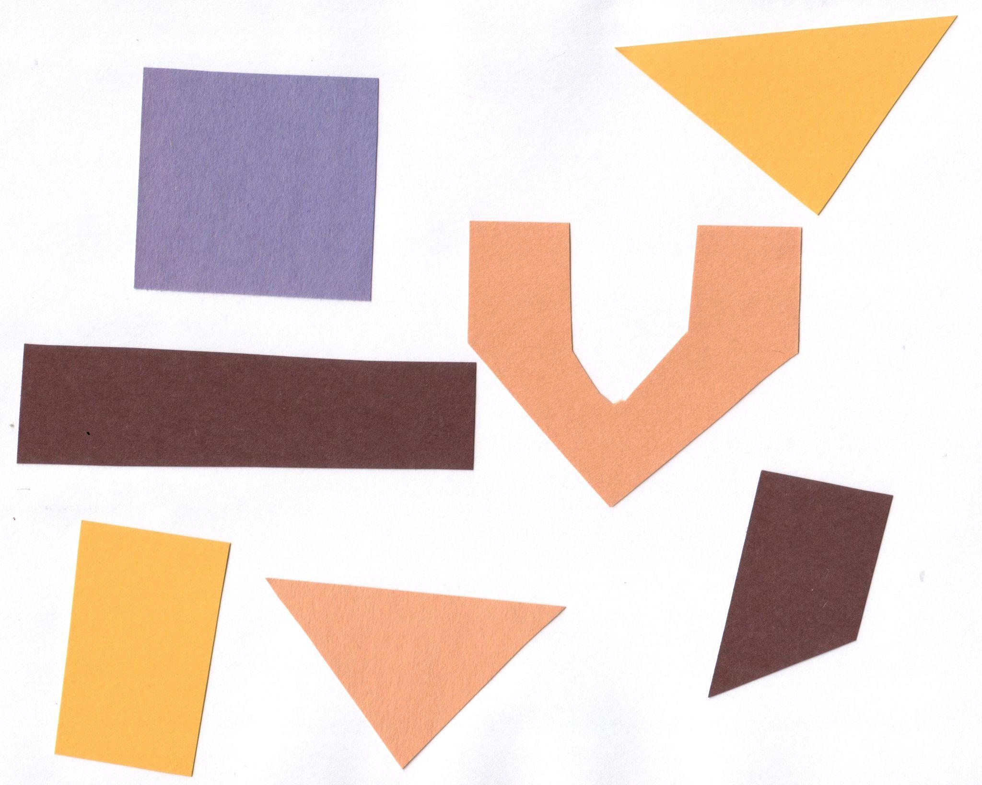
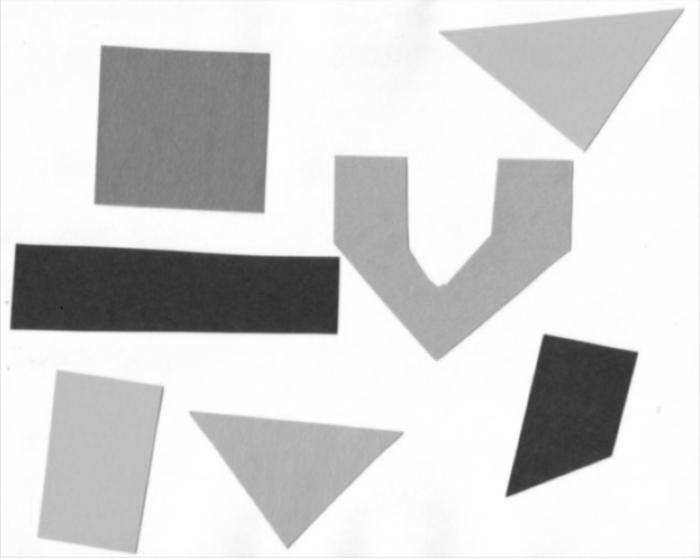

Thresholding
Thresholding is a type of image segmentation, where we change the pixels of an image to make the image easier to analyze. In thresholding, we convert an image from colour or grayscale into a binary image.

Slide 14
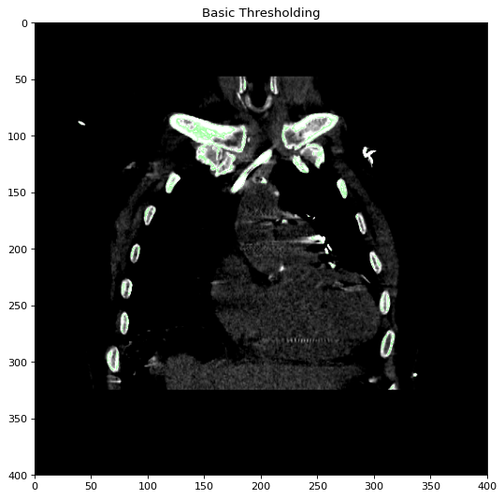
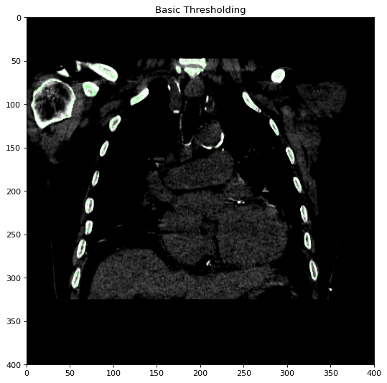
Basic Thresholding
CHEST WITHOUT CONTRAST

Slide 15
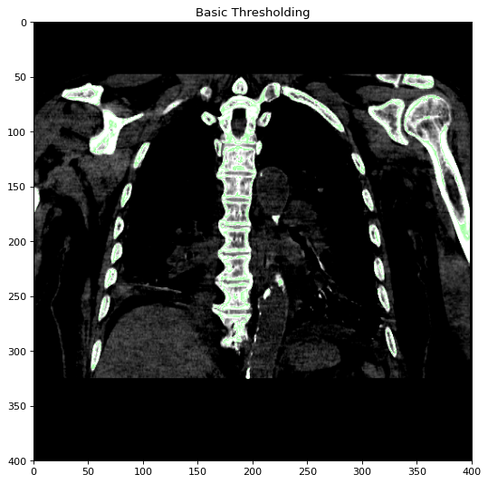
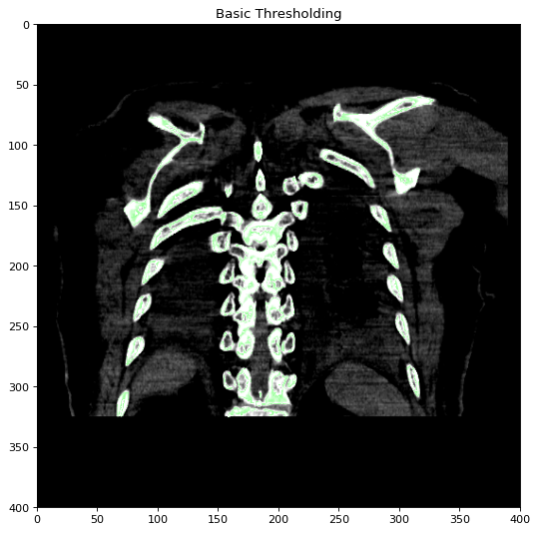
Basic Thresholding

Slide 16
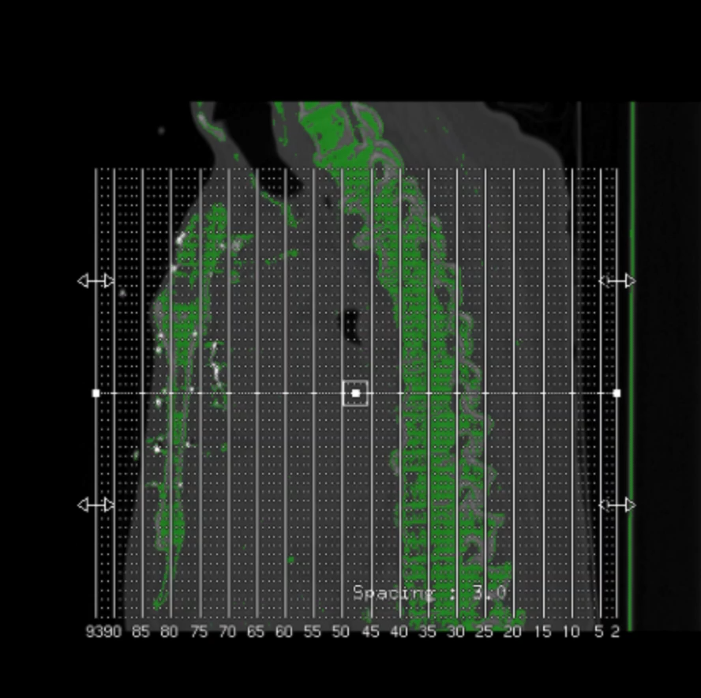
Binary Thresholding
The basic Thresholding technique is Binary Thresholding. For every pixel, the same threshold value is applied. If the pixel value is smaller than the threshold, it is set to 0, otherwise, it is set to a maximum value.

Slide 17
Otsu Thresholding
Otsu method is example for clustering-based image thresholding. In computer vision and image processing, Otsu's method is named after Nobuyuki Otsu, is used to automatically perform the reduction of a gray level image to a binary image.

Slide 18
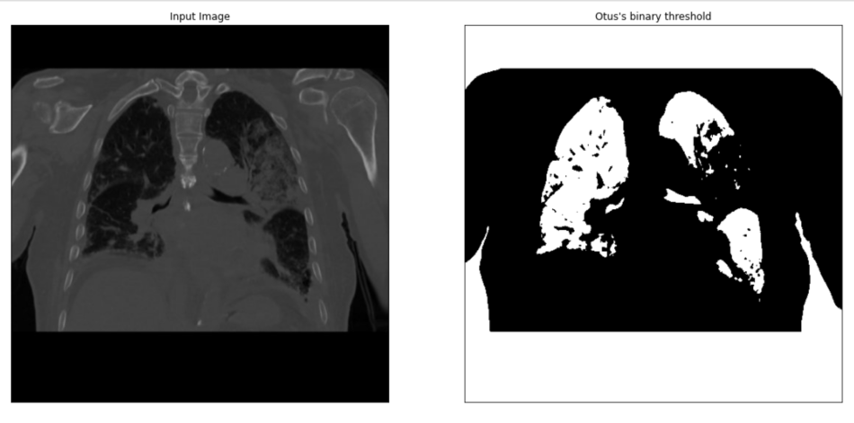
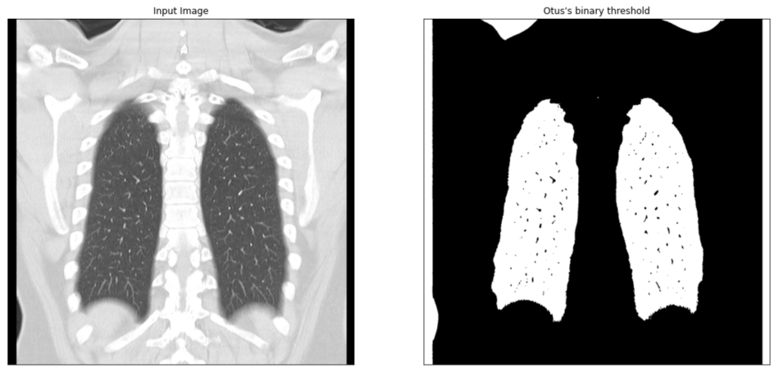
Otsu’s binary thresholding

Slide 19
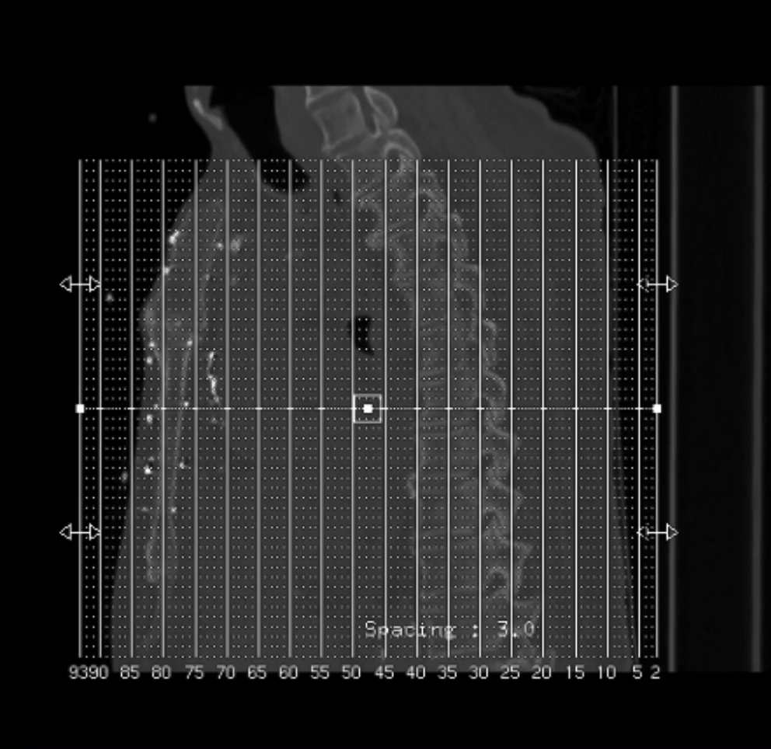
Level-set segmentation
Level set method can be effectively used to solve topology problems during the evolution of curves while the previous algorithms cannot deal with them. In recent years, there are many image segmentation algorithms based on level set method. For different applications of image processing, people have put forward the corresponding solutions, and a large number of researchers also continue to improve and enhance the efficiency and effectiveness of these algorithms.

Slide 20
Watershed Segmentation
Watershed segmentation is a region-based technique that utilizes image morphology. It requires selection of at least one marker (“seed” point) interior to each object of the image, including the background as a separate object. The markers are chosen by an operator or are provided by an automatic procedure that takes into account the application-specific knowledge of the objects.

Slide 21

Gradient Water Segmentation with Edge Features
The gradient magnitude is used to pre-process a gray- scale image before using the watershed transform for segmentation. The gradient magnitude image has higher pixel values along object edges and lower pixel values otherwise. Watershed transform results in watershed ridge lines along object edges.

Slide 22

Watershed Over Segmentation
The result, oversegmentation, is a well-known phenomenon in watershed segmentation. Oversegmentation occurs because every regional minimum, even if tiny and insignificant, forms its own catchment basin. One solution is to modify the image to remove minima that are too shallow.
The main way to deal with watershed over-segmentation is by designing markers for the objects to be reconstructed

Slide 23

Segmentation From Markers
Marker-controlled Watershed is an ImageJ/Fiji plugin to segment grayscale images of any type (8, 16 and 32-bit) in 2D and 3D based on the marker-controlled watershed algorithm (Meyer and Beucher, 1990). This algorithm considers the input image as a topographic surface (where higher pixel values mean higher altitude) and simulates its flooding from specific seed points or markers. A common choice for the markers are the local minima of the gradient of the image, but the method works on any specific marker, either selected manually by the user or determined automatically by another algorithm.

Slide 24
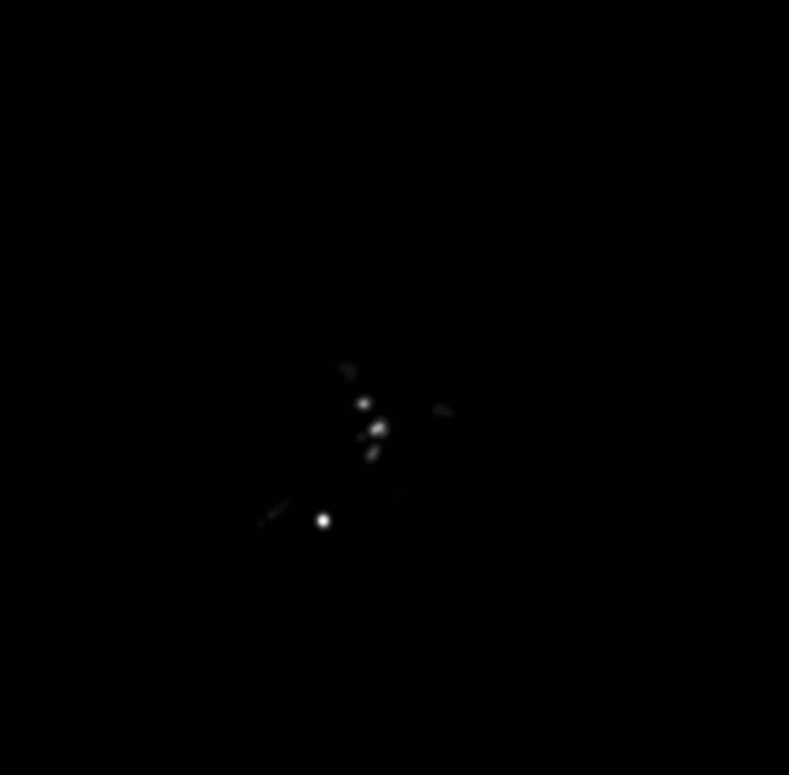
Binary Watersheds for Object Separation

Slide 25

Quantization
Alan please add slides here to show what you were able to do for quantization
Numbers, graphs, metrics are all good

Slide 26
references
https://simpleitk.readthedocs.io/en/master/registrationOverview.html#lbl-registration-overview
https://www.mathworks.com/help/images/ref/imregister.html
https://www.mathworks.com/discovery/image-registration.html
https://www.mathworks.com/help/images/intensity-based-automatic-image-registration.html
https://www.itnonline.com/content/photo-gallery-how-covid-19-appears-medical-imaging
https://biomedical-engineering-online.biomedcentral.com/articles/10.1186/s12938-020-00807-x
https://www.mathworks.com/matlabcentral/fileexchange/25157-image-segmentation-tutorial

